Slide 1
Pitcher Accuracy Metric Database Analysis
David Hoke, Tony Rollin, Jordan Brooks

Slide 2
Database Analysis - Tables
Users: user_id, email, firstname, lastname, password, forgotpassword, verifycode
Teams: team_id, teamname, teamlogo
Pitchers: pitcher_id, (team_id), p_firstname, p_lastname, p_avatar, p_description, p_stats, p_pam, p_track
Tracked: tracked_id, (pitcher_id), (user_id)

Slide 3
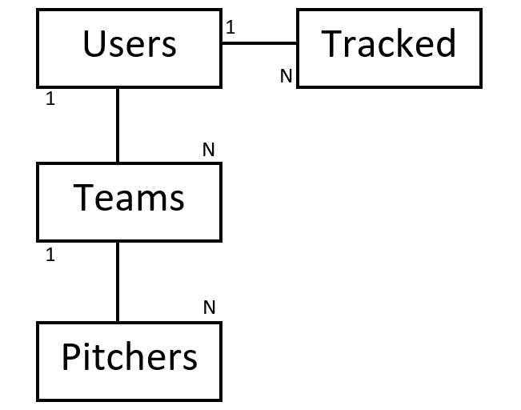
Database Analysis - Diagram

